Slide 1
Digital Design Project Micropocessor DESIGN
Under Superposition of Prof. Islam Yehia

Slide 2
TABLE OF CONTENTS
01
02
03
04
INTRODUCTION
Teamwork Plan
Testing Plan & Design Matrix
Design Steps

Slide 3
01
INTRODUCTION

Slide 4
Introduction
a Microprocessor is a digital device on a chip that can fetch instructions from memory, decode and execute them and give results.

Slide 5
02
Teamwork Plan

Slide 6




5 STEPS Project PROCESS
01
02
03
04
05
Specification Sheet
Block Diagram
RTL for
Sub-Blocks
Control Unit
&
Integration
Testing
Plan

Slide 7
03
Design Steps

Slide 8
Specifications
8-bit Microprocessor.
8 Instructions:
4 Arithmetic.
3 Logic.
1 Branch.
16x8 Rom for data & instructions.

Slide 9
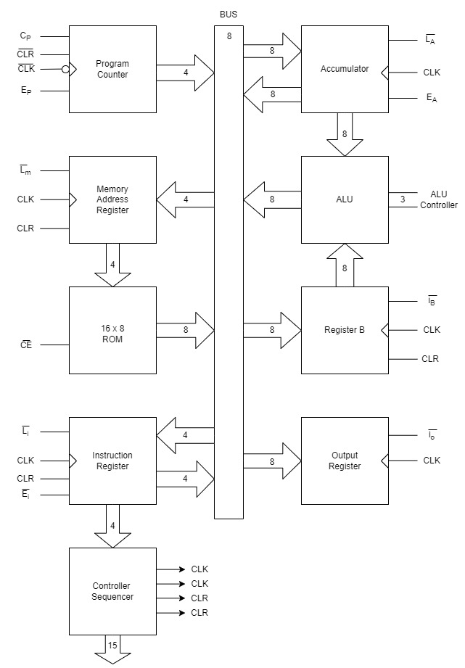

Control Signals
Outputs of Control Unit.
15 Control Signals:
Cp. - $\overline{LA}$.
Ep. - EA.
$\overline{Lm}$. - $\overline{LB}$.
$\overline{CE}$. - $\overline{LO}$.
$\overline{LI}$. - HLT_E.
$\overline{EI}$. - JmpZ.
Alu Controller (3-bits).

Slide 10
Block Diagram
Consists of 9 Sub-Blocks.
Program Counter (PC).
Memory Address Register (MAR).
16x8 ROM.
Instruction Register.
Accumulator.
ALU.
Register B.
Output Register.
Controller Sequencer.

Slide 11
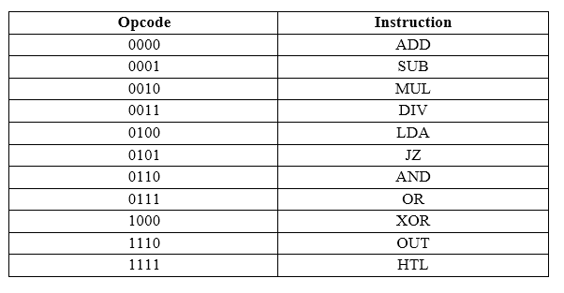
Programming Guide
Op Code for Processor Instruction.
Addressing Mode:
Direct Addressing mode

Slide 12
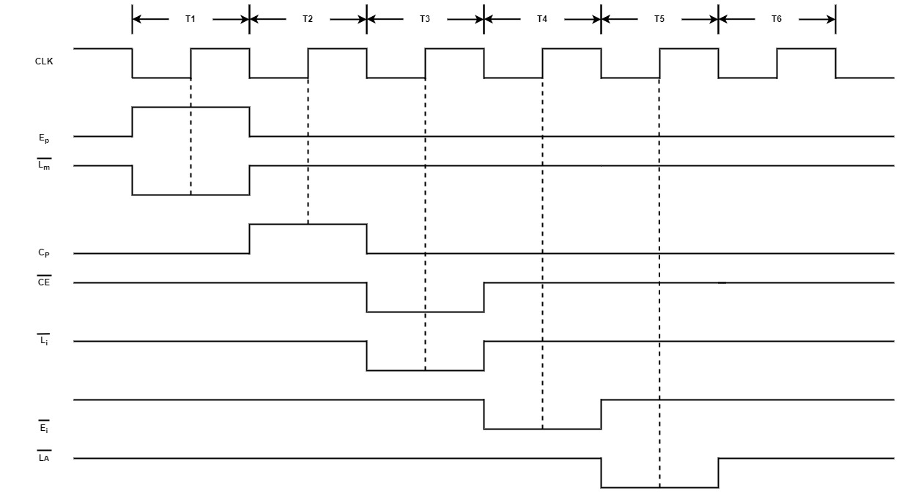
Timing Diagram
LDA Timing Diagram.
T1: Address from PC to MAR.
T2: Incrementing PC.
T3: Instruction from ROM to Instruction Register.
T4: Instruction Field decoded in CU and Address Field to MAR.
T5: Data from ROM to Accumulator.
T6: NOP

Slide 13
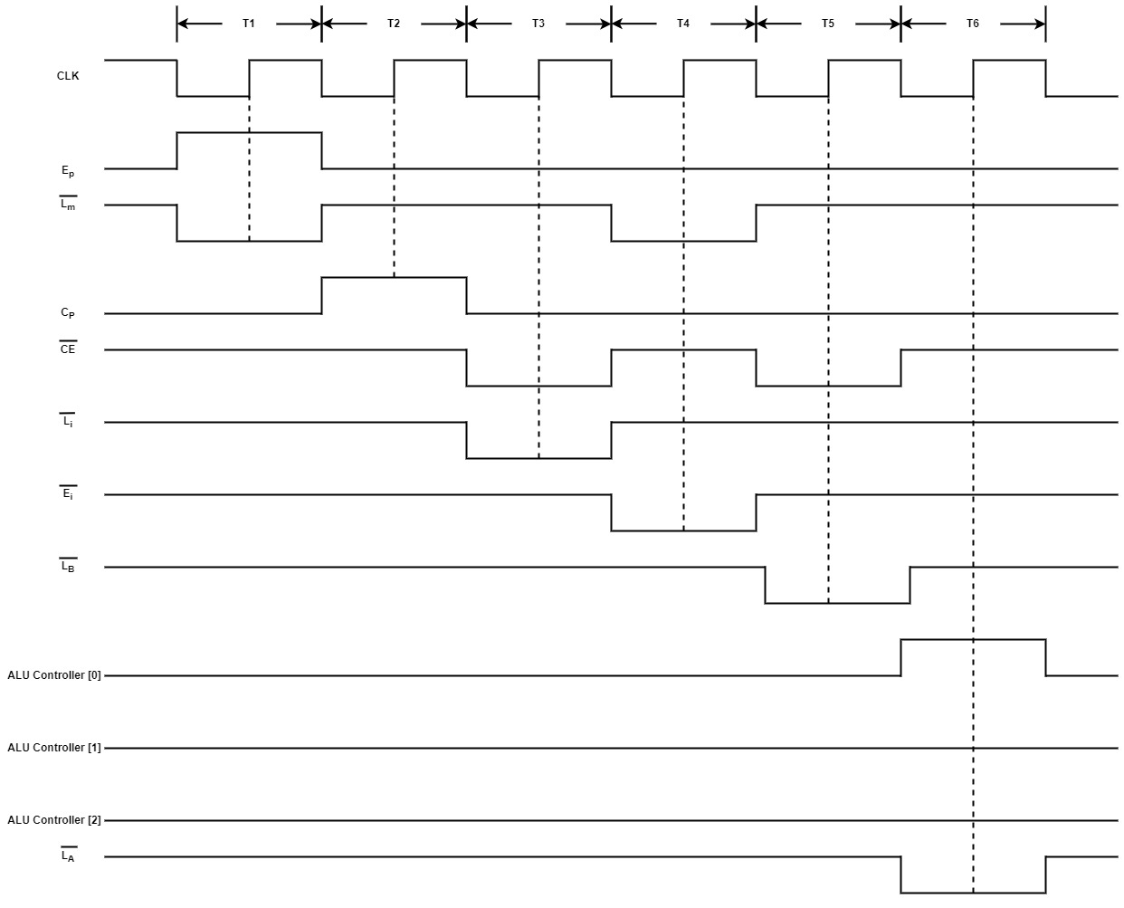
Timing Diagram
ADD Timing Diagram.
T1: Address from PC to MAR.
T2: Incrementing PC.
T3: Instruction from ROM to Instruction Register.
T4: Instruction Field decoded in CU and Address Field to MAR.
T5: Data from ROM to Register B.
T6: ALU Sets up the Accumulator with the result.

Slide 14
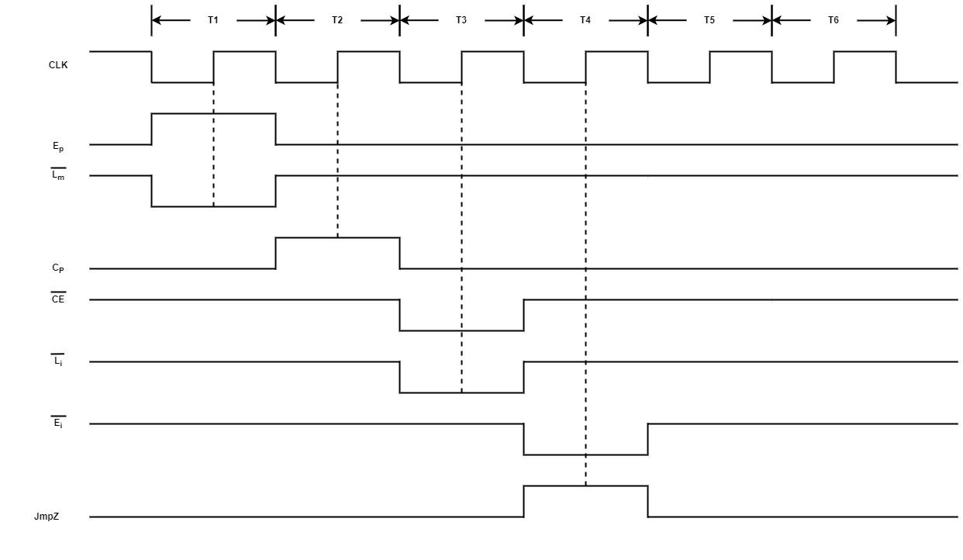
Timing Diagram
JZ Timing Diagram.
T1: Address from PC to MAR.
T2: Incrementing PC.
T3: Instruction from ROM to Instruction Register.
T4: Load PC with the jump address.
T5: NOP.
T6: NOP

Slide 15
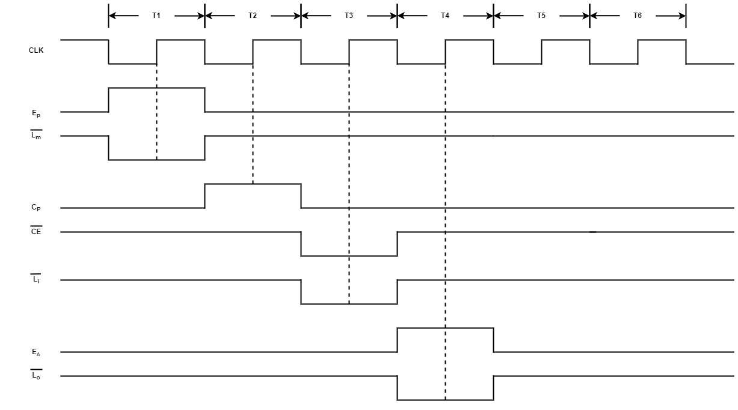
Timing Diagram
OUT Timing Diagram.
T1: Address from PC to MAR.
T2: Incrementing PC.
T3: Instruction from ROM to Instruction Register.
T4: Load the Output Register from the Accumulator.
T5: NOP.
T6: NOP

Slide 16
Testing Plan & Reports
04

Slide 17
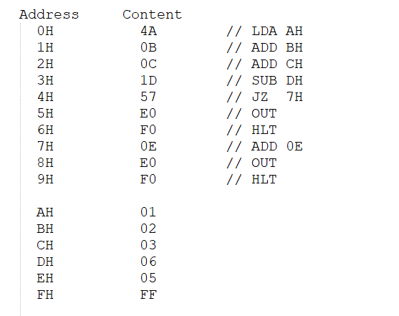
Testing Plan
Program 1:
The following program tests LDA, ADD, SUB, JZ, OUT Instructions.
Out = 1 + 2 +3 – 6 + 5.
Expected Out = 5.

Slide 18
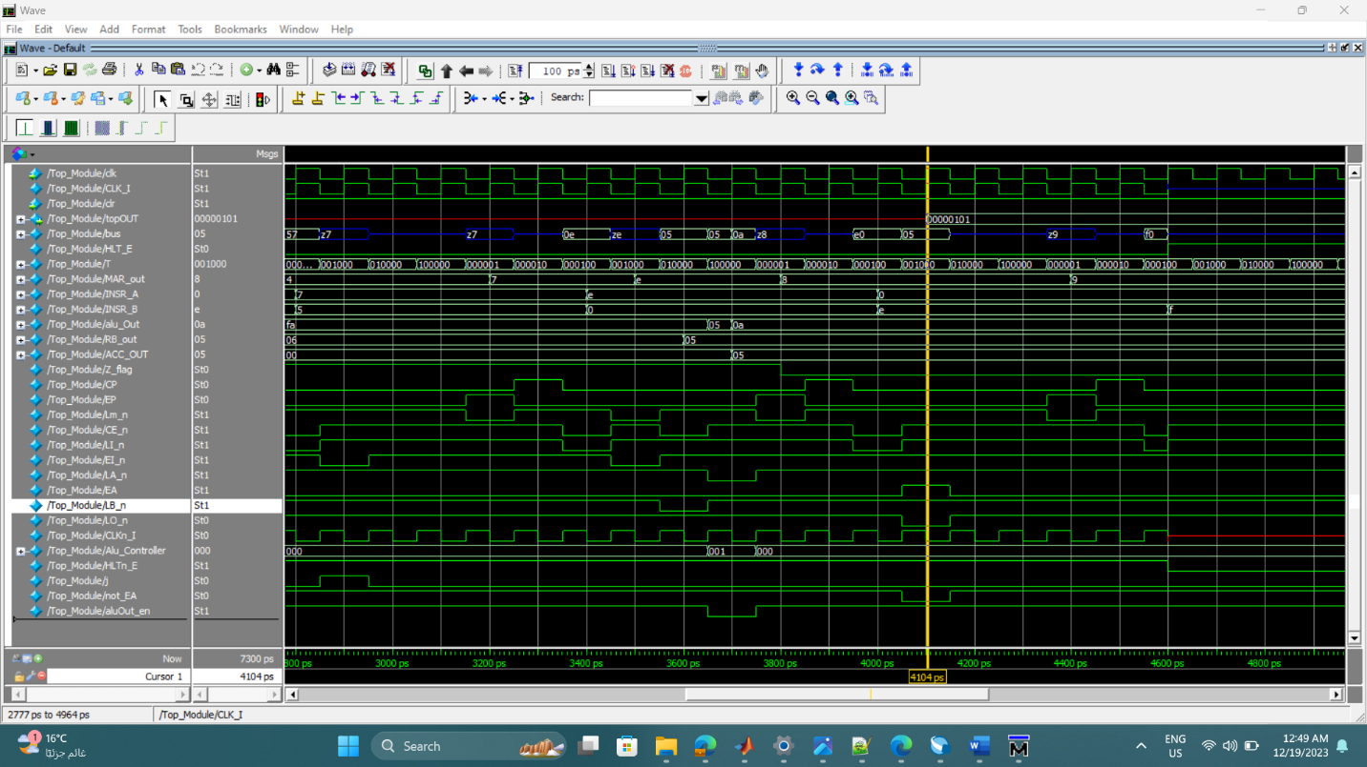

Slide 19
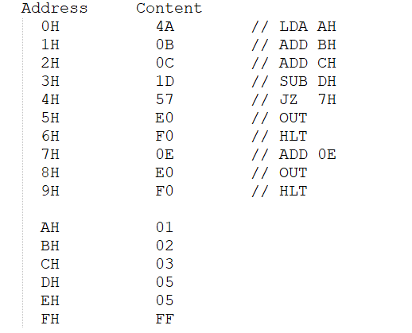
Testing Plan
Program 2:
The following program tests LDA, ADD, SUB, JZ, OUT Instructions.
Out = 1 + 2 +3 – 5.
Expected Out = 1.

Slide 20
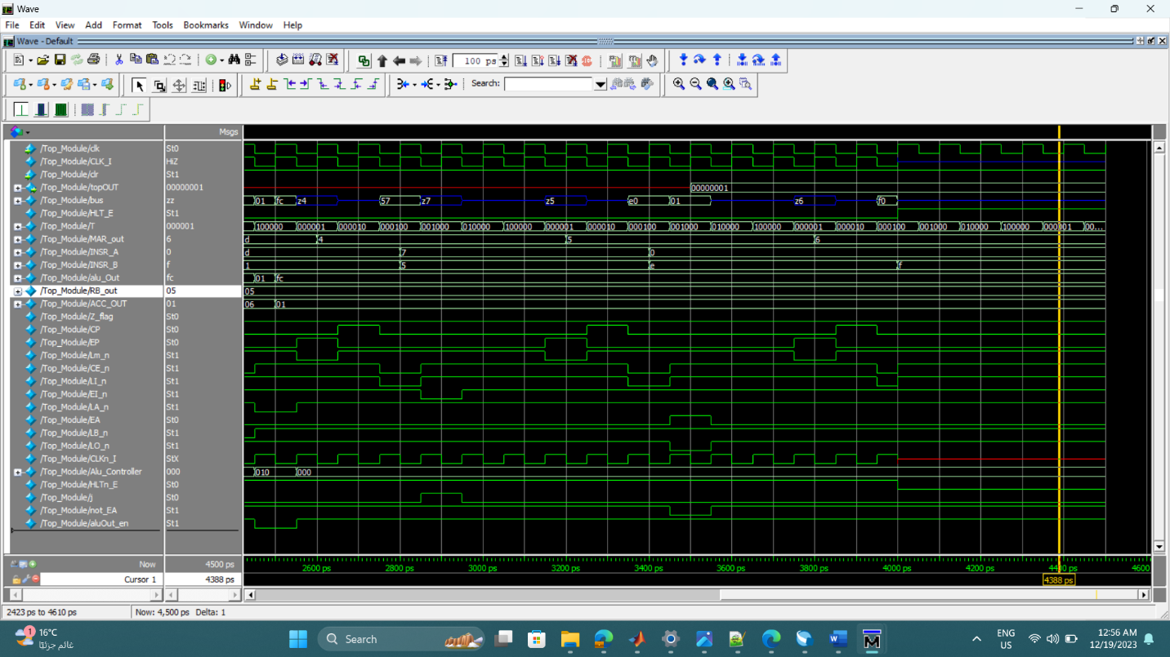

Slide 21
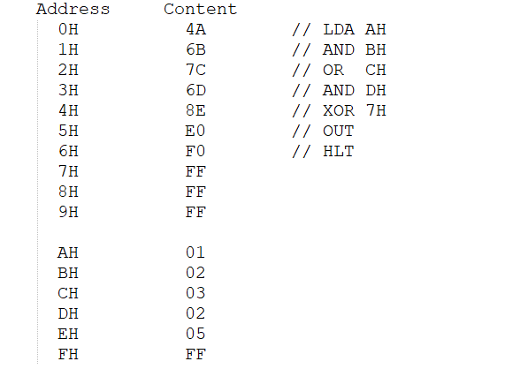
Testing Plan
Program 3:
The following program tests LDA, AND, OR, XOR, OUT Instructions.
Out = (((1 & 2) | 3) & 2) ^ 5.
Expected Out = 7.

Slide 22
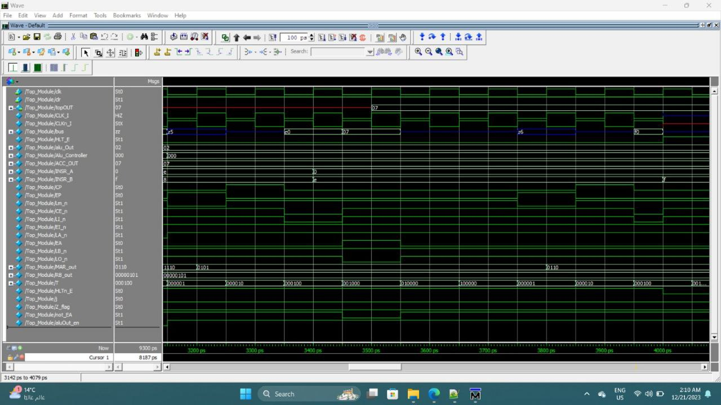

Slide 23
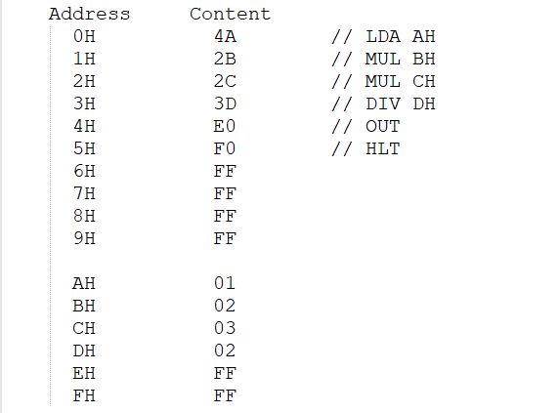
Testing Plan
Program 4:
The following program tests LDA, MUL, DIV, OUT Instructions.
Out = ((1 * 2) *3) /2.
Expected Out = 3.

Slide 24
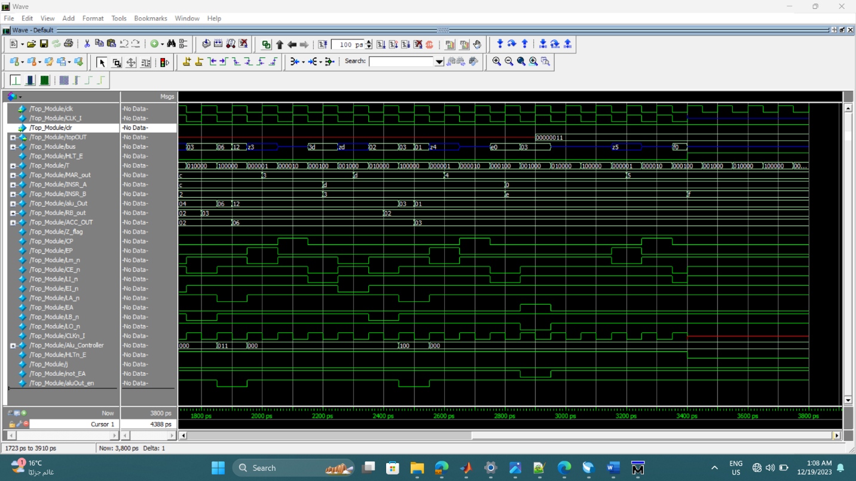

Slide 25
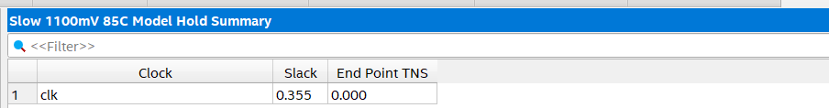
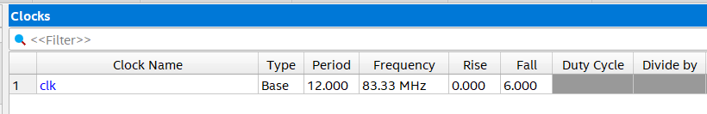
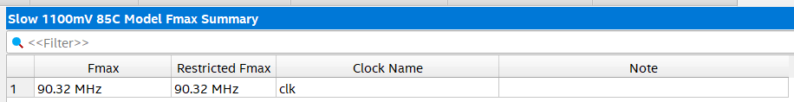
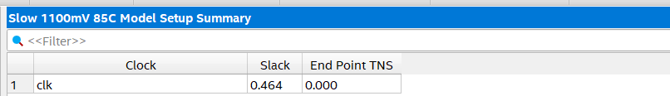
Reports
Timing Reports:
Operating Frequency = 83.33MHz.
Max Frequency = 90.32MHz.
Setup Slack = 0.464.
Hold Slack = 0.355.

Slide 26
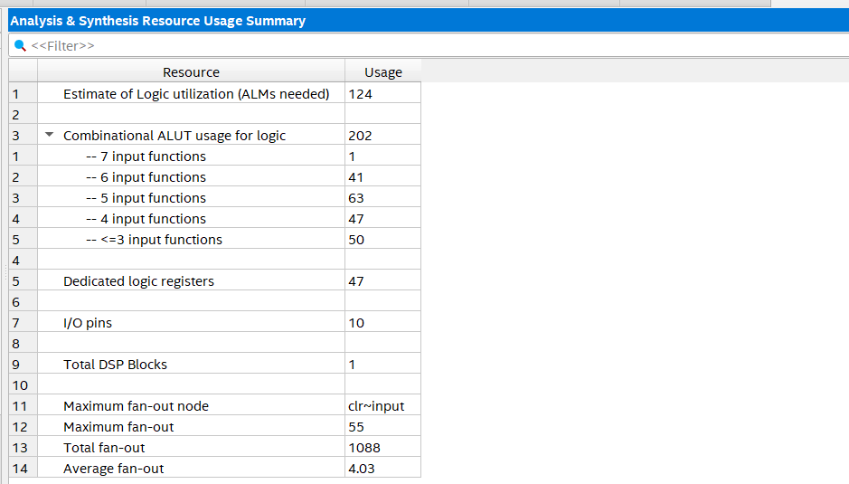
Reports
Resources Report:
Logic Registers = 47.
I/O Pins = 10.
1 Pin for CLK
1 Pin for CLR.
8 Pins for Out.

Slide 27
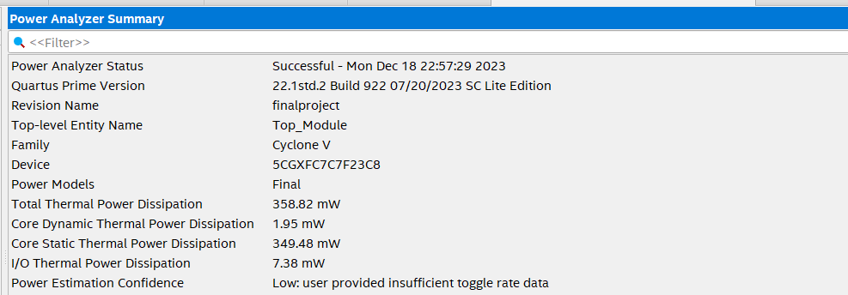
Reports
Power Report:
Total Power Dissipation = 357.82mW.
Dynamic Power Dissipation = 1.95mW.
Static Power Dissipation = 349.48mW.

Slide 28
THANKS

